Slide 1
Video URL
https://youtu.be/CXuFFiIv3mA

Slide 2
SRS Individual Project
Adam Tait
A20303733
Notes:
Hello and welcome to my Individual SRS project,
My name is Adam Tait,
and this project is building on the group project for the VLC Media player

Slide 3
SRS Overview and Explanation for a Stakeholder
Self-Reflection on SRS Project
Notes:
There will be two parts to this project,
First an overview and explanation of the SRS group project on the VLC media player catered to a specific stakeholder,
Followed later by a self reflection on my work in the group project.
Starting with the overview for a stakeholder

Slide 4
Parent Company
VideoLan
Notes:
For my target stakeholder, I have selected the Parent Company. Namely VideoLan

Slide 5
System Vision Model
Goal Model
Notes:
I will summarise the srs project by focusing mainly on two models most relevant to you, the parent company.
First will by the System Vision Model,
Then the Goal Model
Starting with the system vision model,

Slide 6
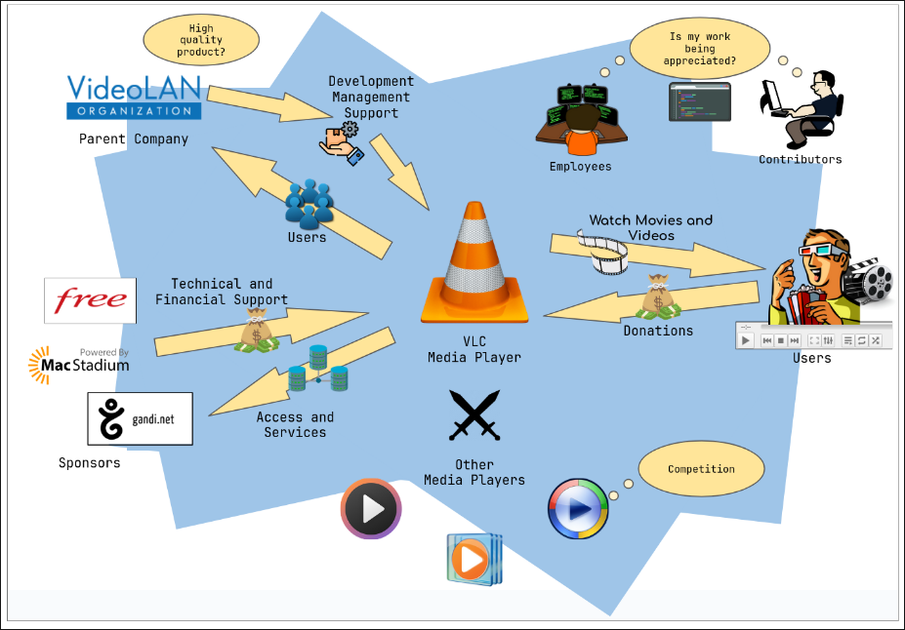
System Vision Model
Notes:
This model highlights the role of the parent company in the overall system
The parent company’s priority here is shown to be creating a high quality product.
It does this by providing user support, project management, and continuous development to the VLC media player.
and in return
it receives a sizeable user base
Along with the parent company’s role being represented in this model,
its important to note the role of the sponsors,
who’s financial support along with
donations from the community makes the whole project possible.
We can also see the importance of heeding any concerns held by the projects developers
All while keeping competition in mind to remain motivated and relevant in the community.

Slide 7
Goal Model
Notes:
That brings us onto the goal model,

Slide 8
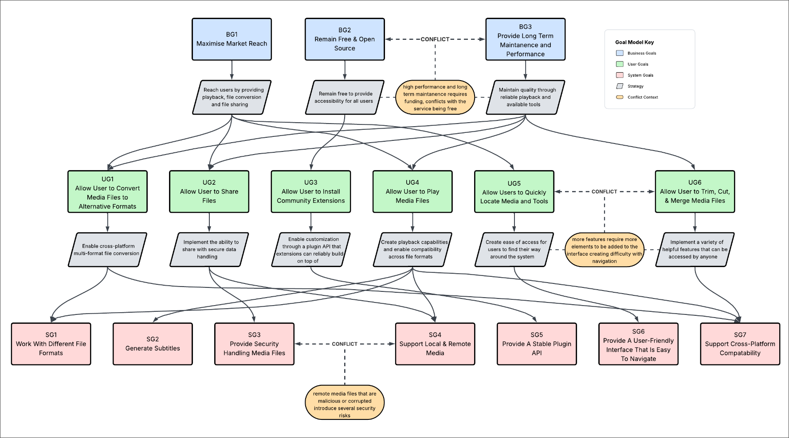
Goal Model
Notes:
This model shows the goals of the project
For the purposes of this presentation we can draw most of our attention to the business goals

Slide 9
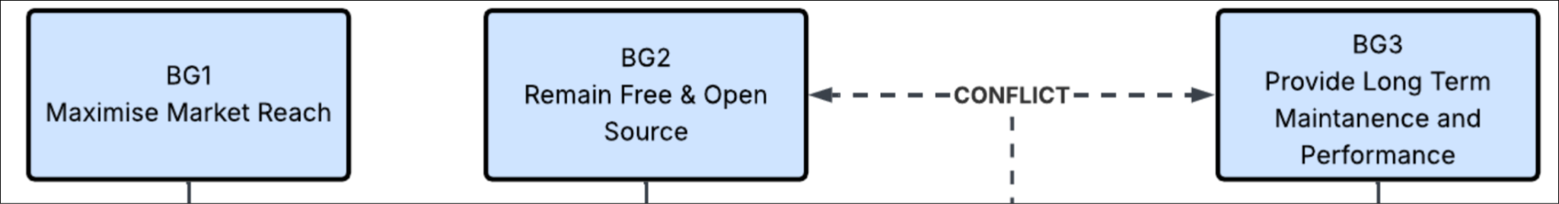
Goal Model
Notes:
These goals include
Maximising the market reach of the project
But remaining free and open source
While providing long term maintenance

Slide 10
Goal Model
Notes:
It's also important to note that the strategies for these goals include
having to balance keeping the project free
and high quality,
as that is an inherent conflicting..

Slide 11
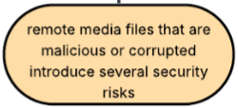
Goal Model
Notes:
Along with the business side of things, we must also be responsible for our project operating within any legal obligations associated with
file sharing in both the individual and community use cases.
This serves to protect the company but also the user,
in cases of malicious file transfers.

Slide 12
Relevant Requirements
Notes:
So, the requirements that are most relevant to you, the parent company, are…

Slide 13

Remain free and open source
Provide long term maintenance
Maximise market reach
Legal issues
Support multiple platforms
Notes:
Keeping the project free and open source
Providing long term maintenance
Maximising the market reach
And navigating any legal issues associated with online file transfers or
licensing on different platforms

Slide 14
Points of Clarification
Notes:
Now, there a few points that I feel need clarification…

Slide 15

Security
How will you ensure the protection of users security from malicious external media without compromising the user’s autonomy to use VLC media however they want?
Brand Image
How will you progress the market reach of VLC? How will you allocate funds towards marketing? How will you justify any spending to the other stakeholders?
Funding
What if donors / sponsors stop supporting? How will you ensure continued financial support from community?
Notes:
First of all,
Security.
How will you ensure the protection of users security from malicious external media without compromising the user’s autonomy to use VLC media player however they want?
As well as security,
Brand image.
How will you progress the market reach of VLC?
How will you allocate funds towards marketing?
How will you justify any spending to the other stakeholders?
Speaking of spending, the last point is
Funding.
What will you do if donors and sponsors stop supporting? Would you consider a freemium business model? More importantly, how will you ensure continued financial support from community to avoid this situation?

Slide 16
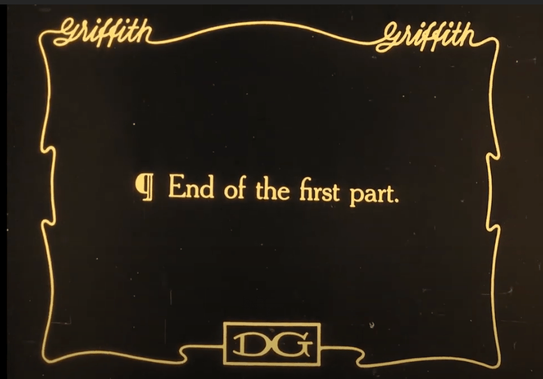
Notes:
That brings us to the end of part one of this presentation!

Slide 17
Self-Reflection on SRS Project
Notes:
Now, onto the self reflection of my contributions to the srs project…

Slide 18
Strengths and Weaknesses
Notes:
The first aspect of this part will be discussing my strengths and weaknesses during the project.

Slide 19

Strengths
Researching stakeholders
System vision
Incorporation of feedback
Notes:
First of all my I think my strengths include the initial work I put in researching the stakeholders involved with VLC by reading through their website to find partners and sponsors and so on.
Next, I believe my biggest strength was the work I put in for the System Vision Diagram
It was the aspect I put the most work into by far and I’m proud of how it turned out in the end.
And lastly , I’m happy with how I improved on the design from the first draft by incorporating the feedback received,

Slide 20
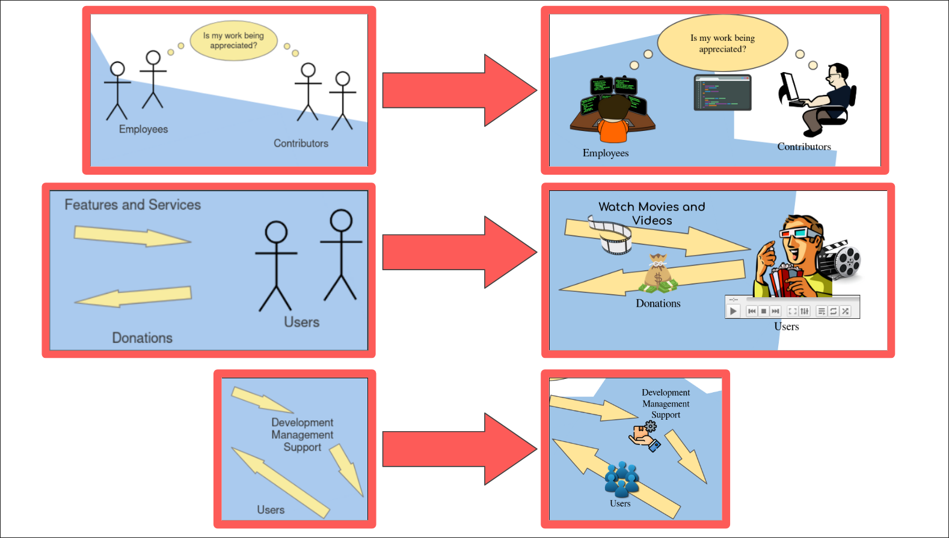
Strengths
Researching stakeholders
System vision
Incorporation of feedback
Notes:
improving on the placeholder stick figures with images representing the different groups,
adding more visual cues that vlc is a media player,
And adding a some extra icons to bring the key aspects to life.

Slide 21

Strengths
Weaknesses
Researching stakeholders
System vision
Incorporation of feedback
Time management
Workload management
Proactive engagement
Notes:
Now onto my weaknesses.
I think my shortcomings definitely included time management,
workload management,
and not being proactive enough in my involvement with the projects,
I often found aspects of the project I wanted to help with had already been tackled by more proactive members of my group.

Slide 22
Most Difficult Part
Notes:
So…
the part I found the most difficult of working on the SRS project was definitely…

Slide 23

Admitting when I was confused / asking for help from the group
Notes:
Admitting when I was confused or asking for help from the group.
I think this was particularly difficult for me because I am driven to be independent and I can struggle with not wanting to coming across as unintelligent.

Slide 24
What I would do differently
Notes:
That being said, if I could go back and do anything differently I would …

Slide 25


Communicate
More openly and actively.
Notes:
Communicate more openly and actively with the group.
I believe being able to collaborate more efficiently early on would have lead me to be more helpful throughout the entire project,
and leave a more significant impression on the work for me to be proud of.

Slide 26
Thank You!
Notes:
That’s all for my presentation, thank you for your time!

